Slide 1
Simple Backtester Project
Ashwin Rajesh
CS 7319
April 2022

Slide 2
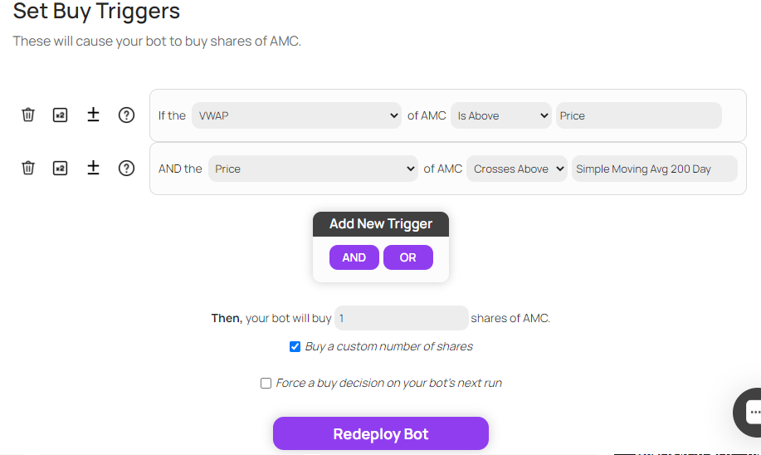
Project Scope
Architecture
Selection
Introduction
Decision
Demo

Slide 3
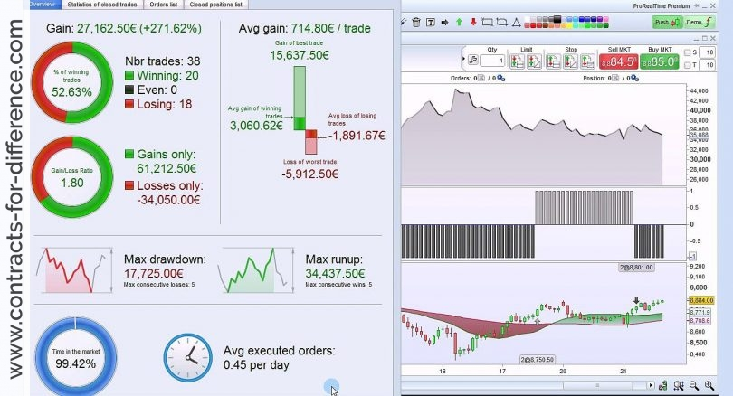
What is Backtesting?
Architecture
Selection
Introduction
Decision
Demo

Slide 4
Architecture #1 Component Diagram
Database with raw stock data
POST Request
Batch Sequential Approach
Request Handler
Base Stock Runner
Strategy Runner
Updated JSON Results
Grapher
Graphical Visualization of PnL
Architecture
Selection
Introduction
Decision
Demo

Slide 5
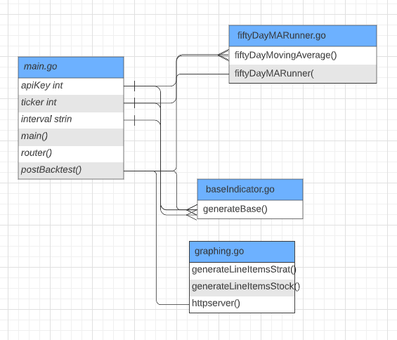
Architecture #1 Class Diagram
Architecture
Selection
Introduction
Decision
Demo

Slide 6
Architecture #1 Mapping
Database with raw stock data
POST Request
Request Handler
Base Stock Runner
Strategy Runner
Updated JSON Results
Grapher
Graphical Visualization of PnL
Architecture
Selection
Introduction
Decision
Demo

Slide 7
Architecture #2 Component Diagram
Pipe and Filter Approach
Triggered by POST request with required params to Golang API
Stream contains both strategy performance data in json format and base stock performance
Database with raw stock data
Parse Raw Data
Via api request calls with JSON response
Run Simulation
Executes a one-week backtest of the stock based on json parameters
Generate Results
Outputs data to end user via console and graph visualization
Stream
Stream
We use polygon.io for stock API requests
In: json data structures
Out: none
In: json data structures
Out: none
Architecture
Selection
Introduction
Decision
Demo

Slide 8
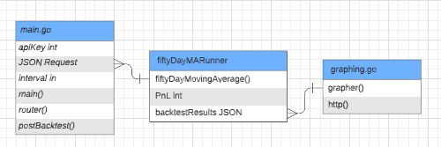
Architecture #2 Class Diagram
Architecture
Selection
Introduction
Decision
Demo

Slide 9
Architecture #2 Mapping
Triggered by POST request with required params to Golang API
Stream contains both strategy performance data in json format and base stock performance
Database with raw stock data
Parse Raw Data
Via api request calls with JSON response
Run Simulation
Executes a one-week backtest of the stock based on json parameters
Generate Results
Outputs data to end user via console and graph visualization
Stream
Stream
We use polygon.io for stock API requests
In: json data structures
Out: none
In: json data structures
Out: none
Architecture
Selection
Introduction
Decision
Demo

Slide 10
Evaluation & Comparison
Separate programs are executed in order; data is passed as an aggregate from one program to the next via connectors: “The human hand” vs Pipes with data streams
Explicit, aggregate elements passed from one component to the next upon completion of the producing program’s execution vs Independent filters with know knowledge of up or downstream filters
Architecture
Selection
Introduction
Decision
Demo

Slide 11
Selected Options
Batch Sequential
Using REST API and Client Server to handle interactions with backtester
Architecture
Selection
Introduction
Decision
Demo

Slide 12
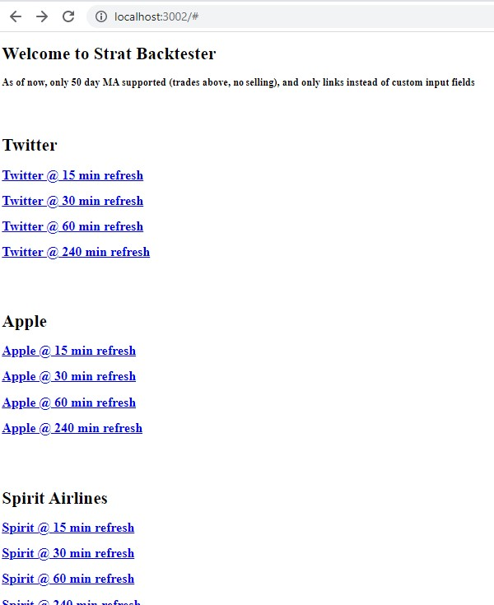
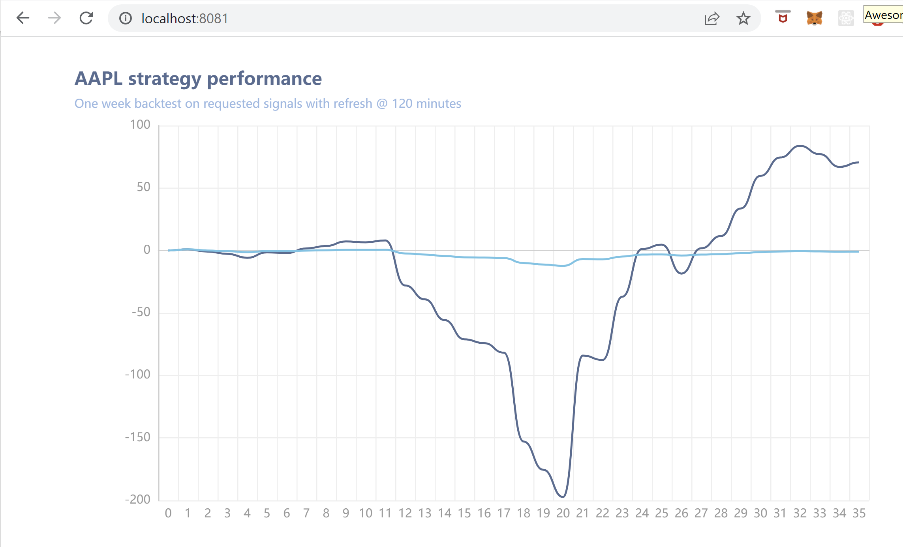
Demo
Architecture
Selection
Introduction
Decision
Demo

